Slide 1
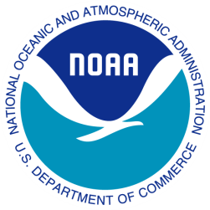
Graduate and Early Career Opportunities at NOAA
Marlene Kaplan
Deputy Director of Education
NOAA
September 2014
August 2014

Slide 2
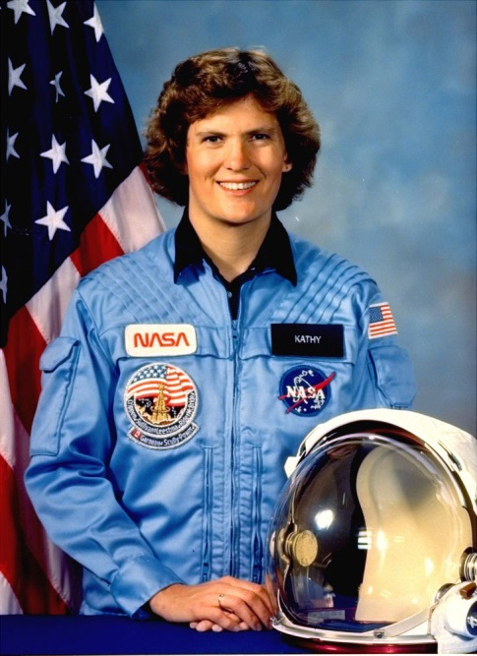
New Under Secretary
Dr. Kathryn Sullivan named one of Time’s most influential people in 2014

Slide 3
New Chief Scientist
Former head of:
National Ocean Service (NOS)
Office of Oceanic and Atmospheric Research (OAR)

Slide 4
NOAA’s Mission
Science, Service, and Stewardship.
To understand and predict changes in climate, weather, oceans, and coasts,
To share knowledge and information with others, and
To conserve and manage coastal and marine ecosystems and resources

Slide 5
Paths to NOAA
USAJobs
Contract workforce
Cooperative Institutes
Fellowship Programs
Knauss
EPP
Postdoctoral Fellowships
NOAA Corps

Slide 6
Contract Workforce
Here is a list of companies who are currently filling contract positions at NOAA:
Aster Engineering
BAE Systems
Consolidated Safety Services
Earth Resources Technology
OAK Management
IM Systems Group
JHT, Inc.
SAIC Systems
Tetra Tech
Versar

Slide 7
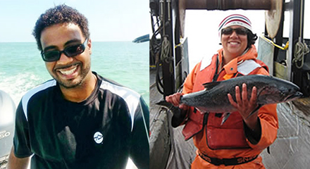
EPP Graduate Research Scholars

Slide 8
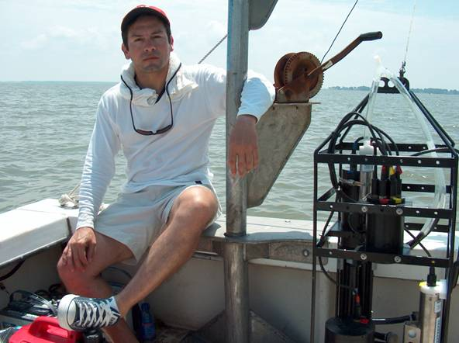
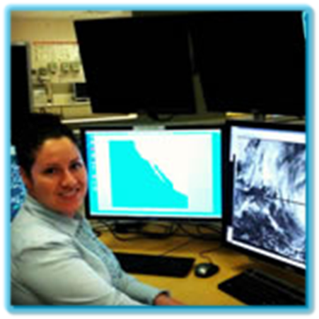
EPP Alumni at NOAA

Slide 9
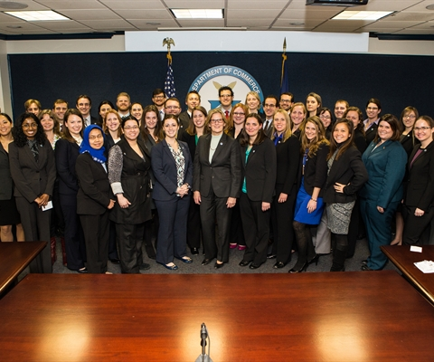
Knauss Fellowships
John A Knauss Marine Policy Fellowship
The Sea Grant Knauss Fellowship provides a unique educational experience to graduate students who have an interest in ocean, coastal and Great Lakes resources and in the national policy decisions affecting those resources.
The Fellowship, named after one of Sea Grant's founders, former NOAA Administrator, John A. Knauss, matches highly qualified graduate students with "hosts" in the legislative and executive branch of government located in the Washington, D.C. area, for a one year paid fellowship.

Slide 10
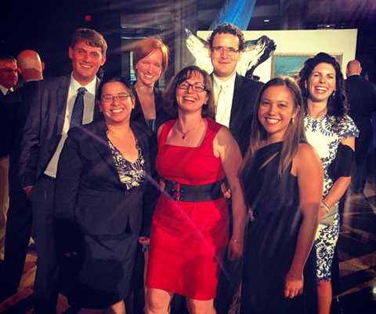
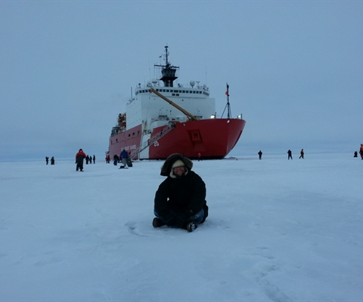
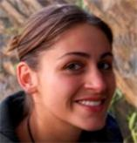
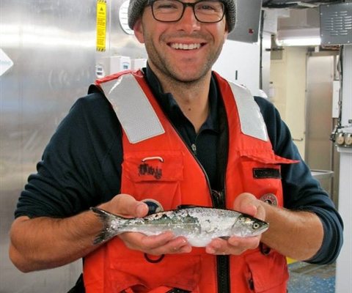
Knauss Fellows

Slide 11
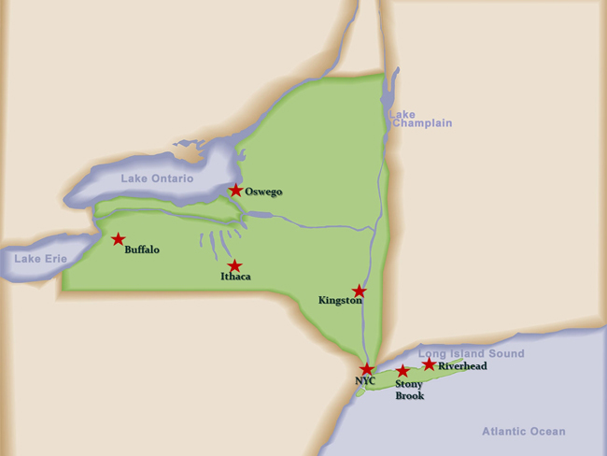
NY Sea Grant
Hurricane Education
Climate Change
Harmful Algal Blooms
Hudson River | NY City
Coastal Community Development
Fisheries: Marine | Great Lakes
NEMO/Water Quality
LI Sound
SUNY Stony Brook

Slide 12
Postdoctoral Fellowships
EPP
UCAR
NOAA Climate and Global Change
Postdocs Applying Climate Expertise (PACE)

Slide 13
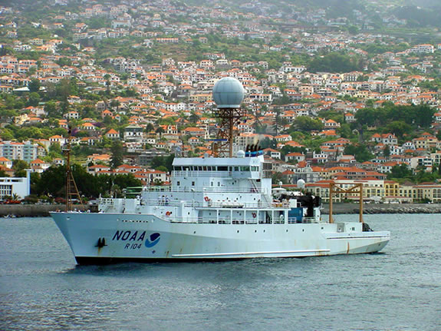
NOAA CORPS
321 Commissioned Officers
Prefer people trained in engineering, the physical and life sciences, or math

Slide 14
Benefits of CREST
CREST and NOAA Scientists
Applied research
Industry partners
Internships
Opportunities across sectors

Slide 15
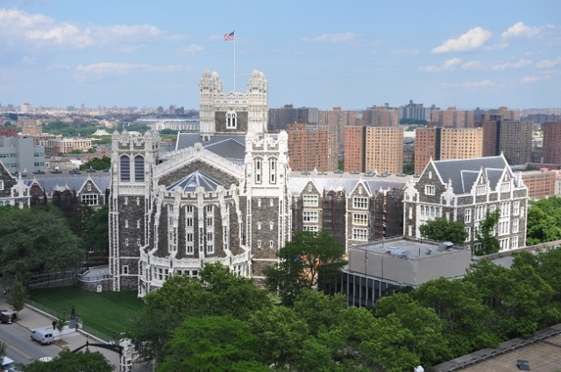
Your success is important to us
Please keep in touch with CREST and NOAA about your career path

Slide 16
EPP Education and Science Forum
October 26 – 29

Slide 17
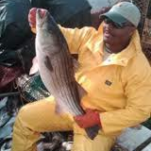
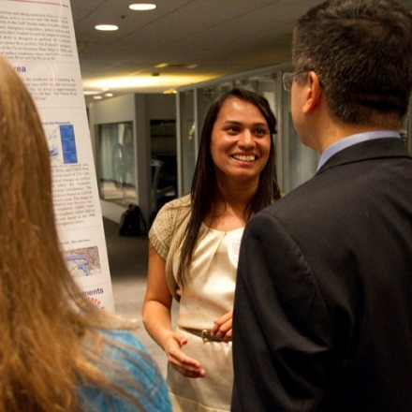
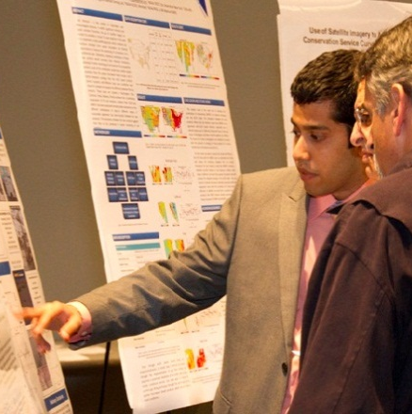
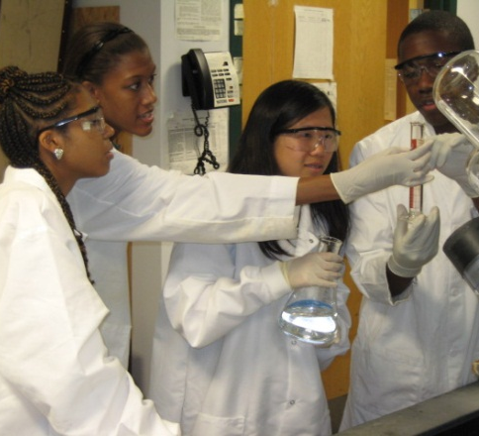
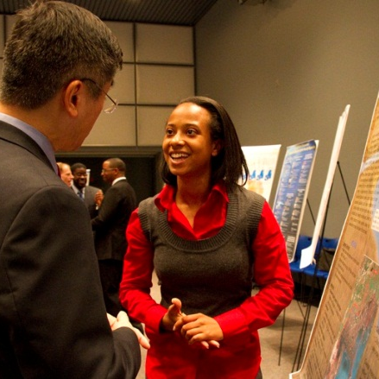
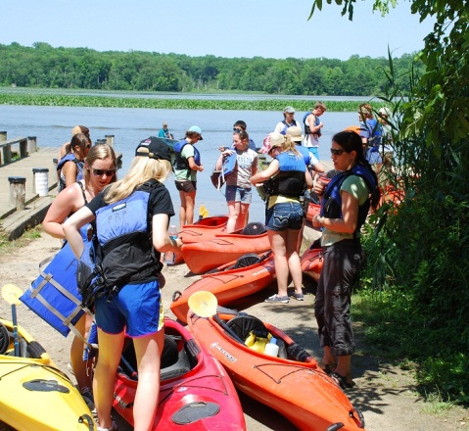
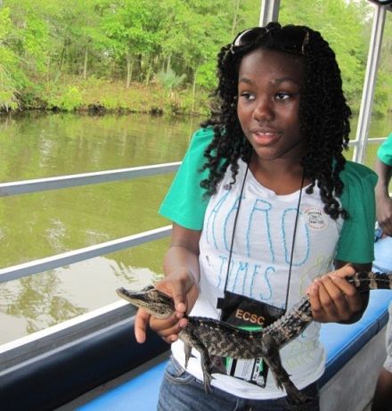
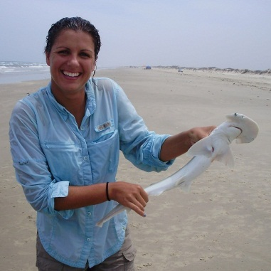
Find Out More
www.education.noaa.gov
www.epp.noaa.gov
Follow us on Facebook!
www.facebook.com/NOAA.HigherEducation.gov

